Slide 1

DIY GARAGE MEBZ
JMPB
Iker Palomares, Yeray Escabias and Oier Letamendia

Slide 2
Oier Letamendia
Introduction

Slide 3
OUR TIMELINE
WEEK 1
WEEK 3
FIRST IDEA
FINAL
VERSION
WEEK 2
WEEK 4
Organization and work planning
Web page, C menu and Database
First steps
Final tuning

Slide 4

TRELLO

Slide 5
Oier Letamendia
C MENU

Slide 6
PROCESS
1st IDEA
FINAL TUNING
MAIN PART
Begin programming the main parts of the menu and specify the functionalities.
Describe the general idea and provide a set of instructions to follow.
Correct errors and do the final tuning.

Slide 7
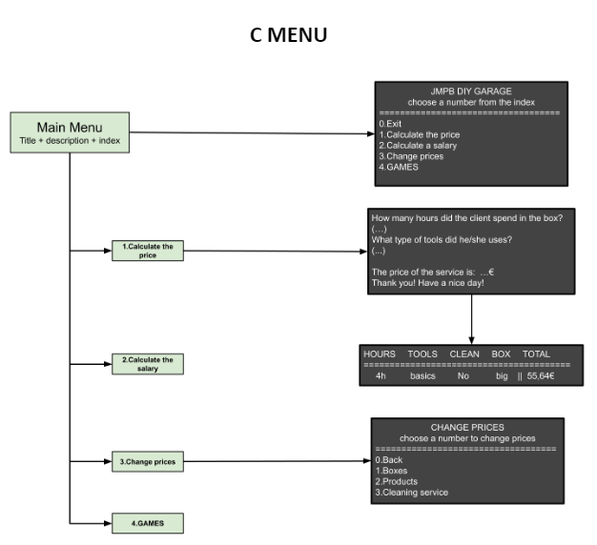
1st IDEA
Define the structure of the program.
General idea of how the functionalities work.

Slide 8
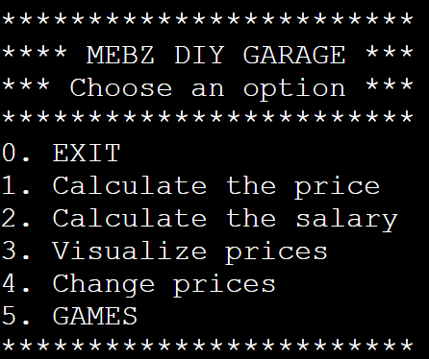
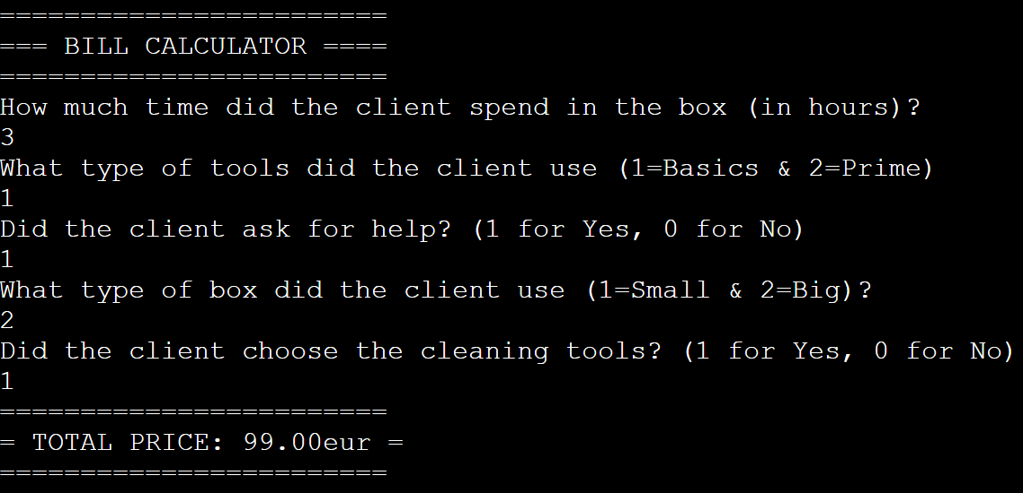
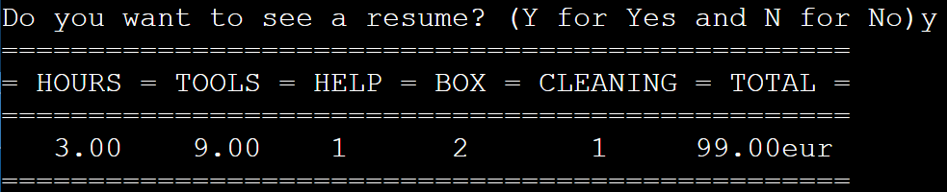
MAIN PART
0
1

Slide 9
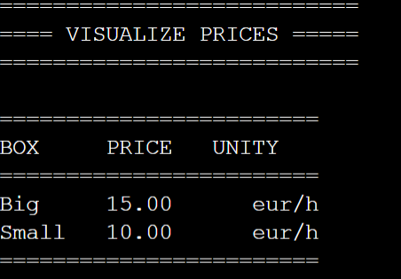
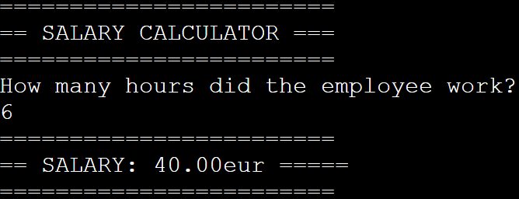
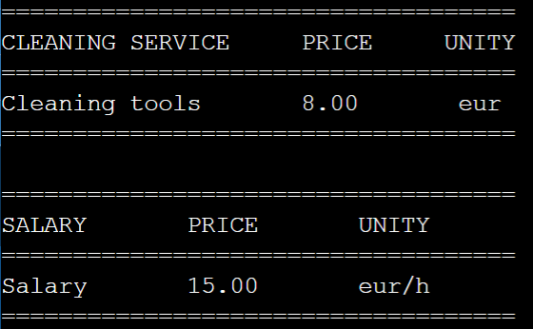
MAIN PART
2
3

Slide 10
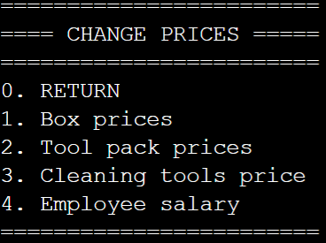
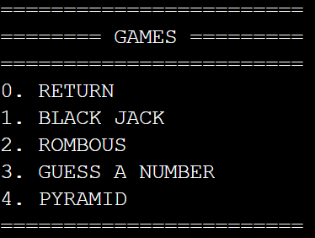
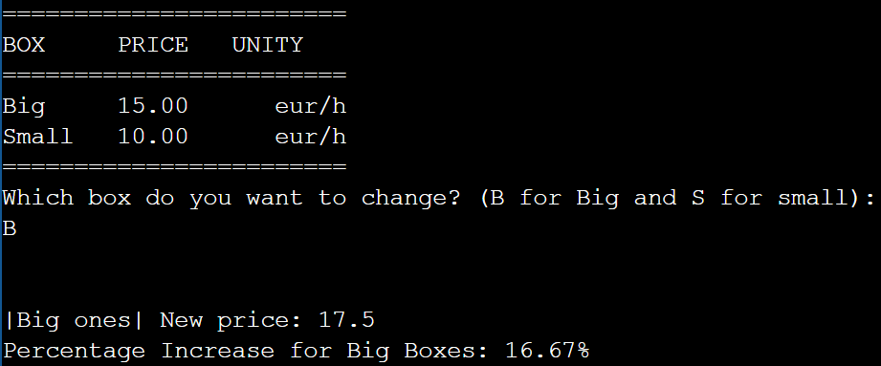
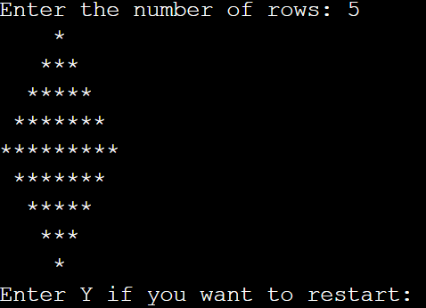
MAIN PART
4
5

Slide 11
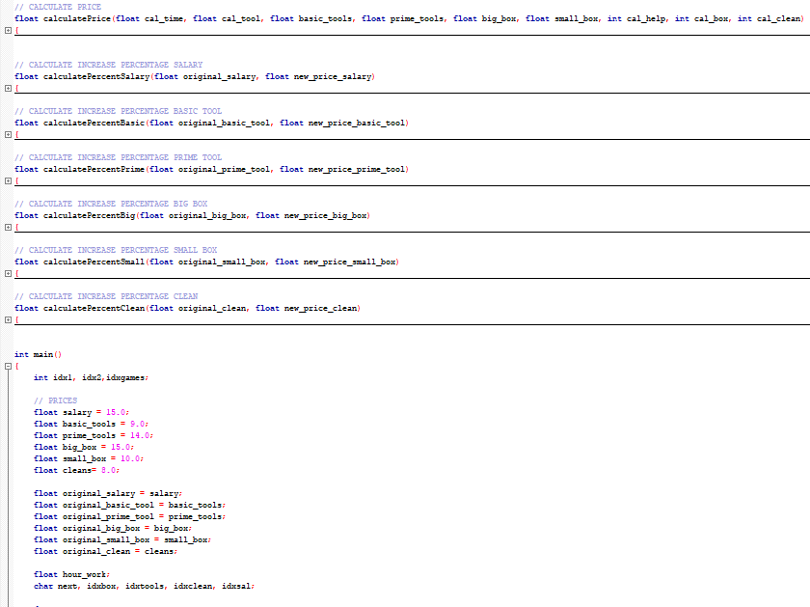
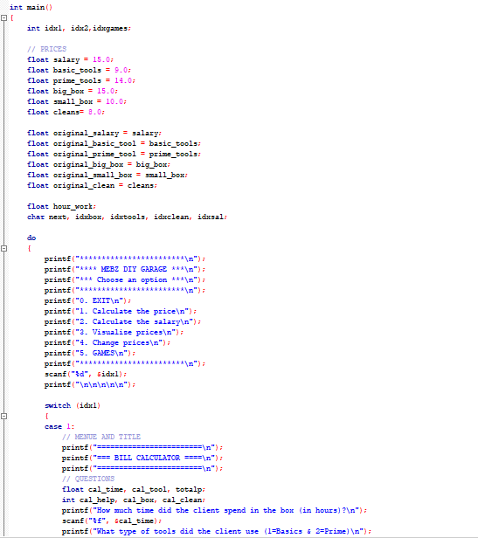
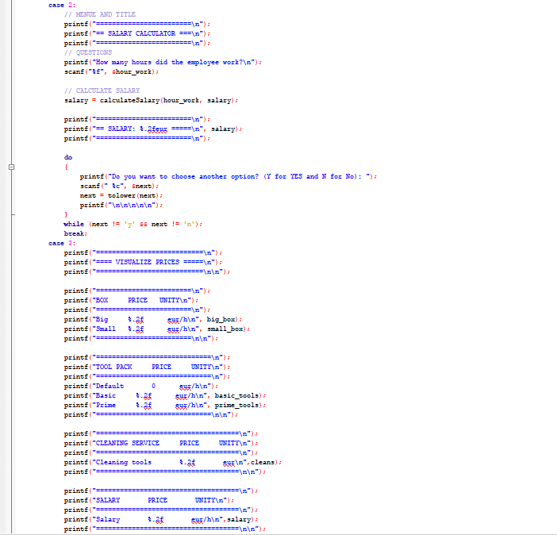
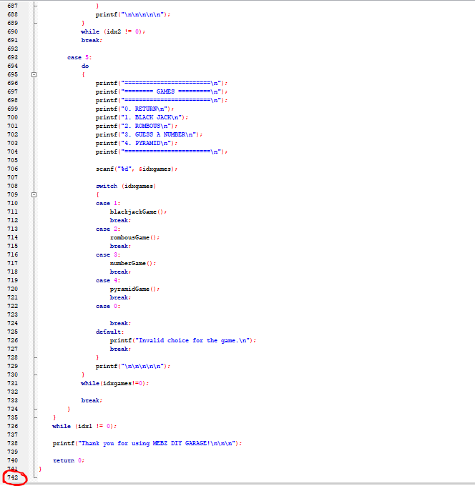
FINAL TUNING

Slide 12
Yeray Escabias
WEB PAGE

Slide 13
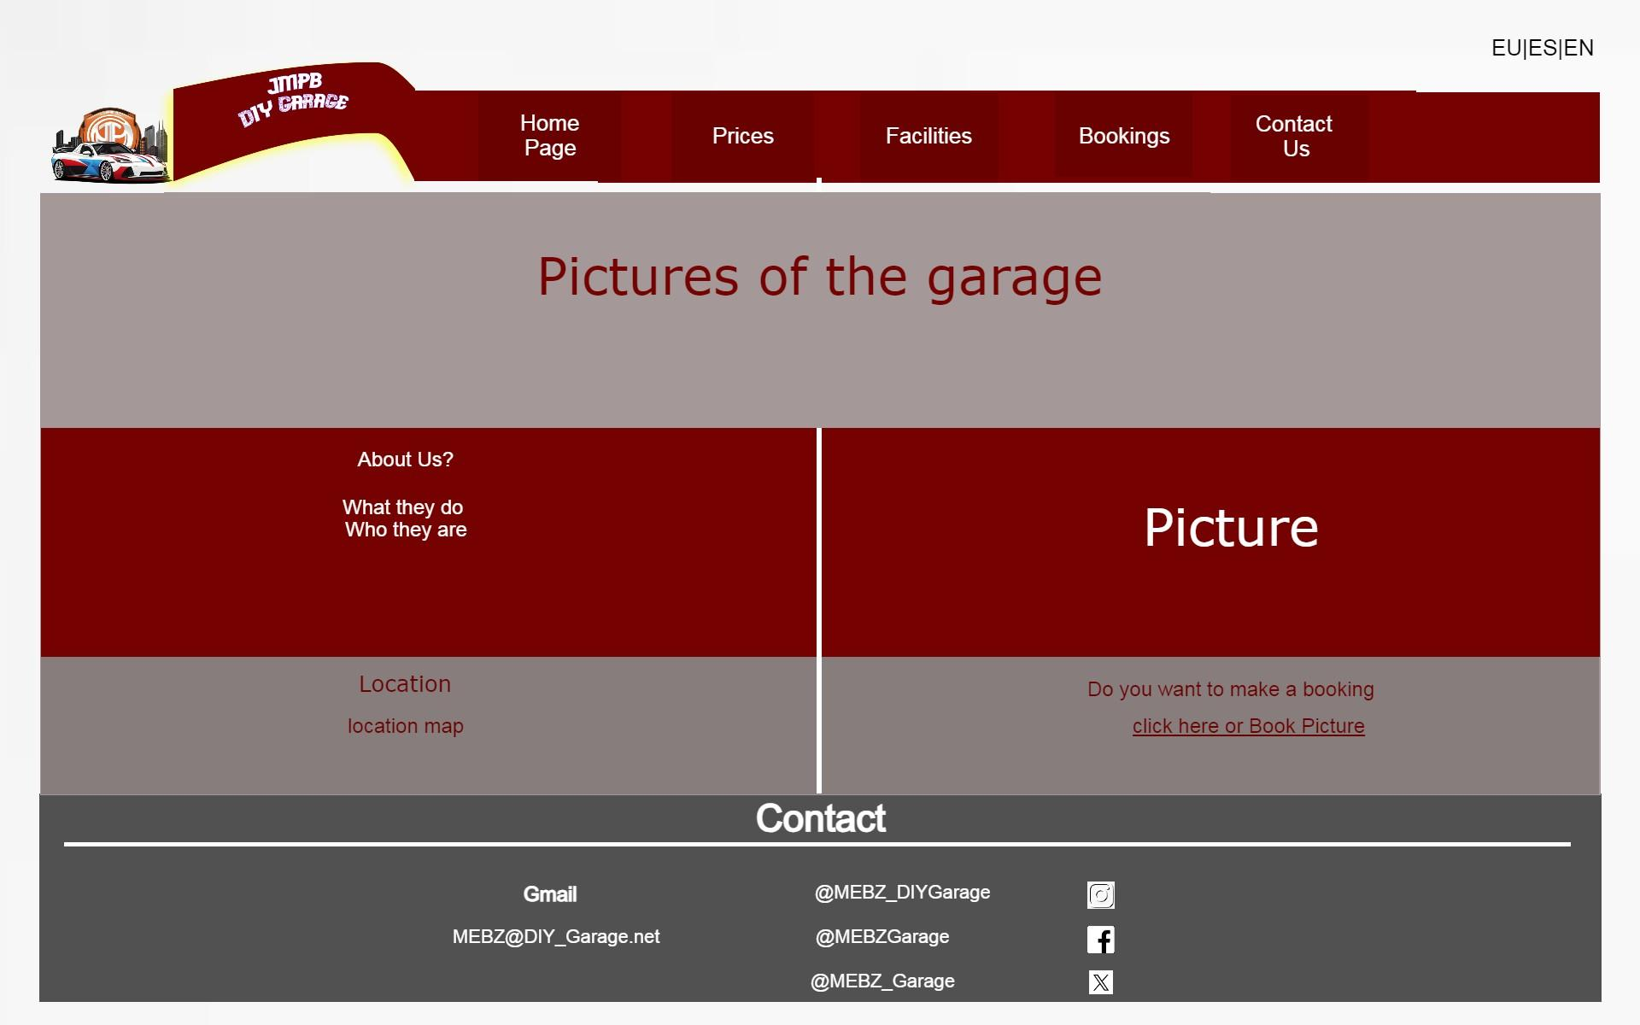
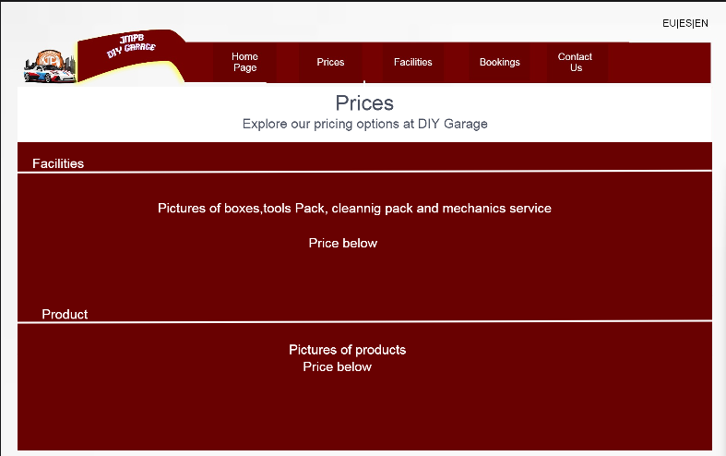
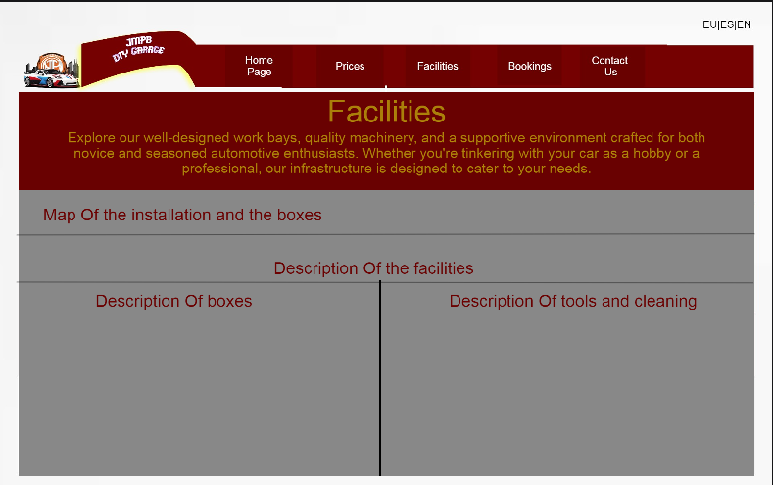
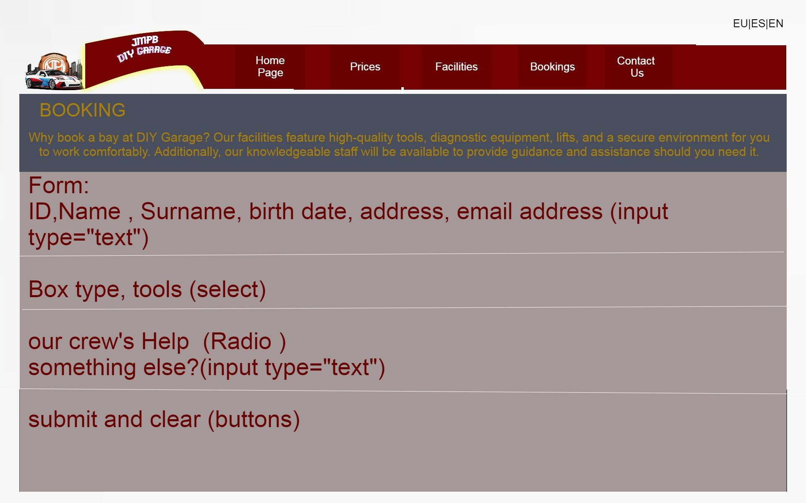
1st IDEA

Slide 14

Home page

Slide 15
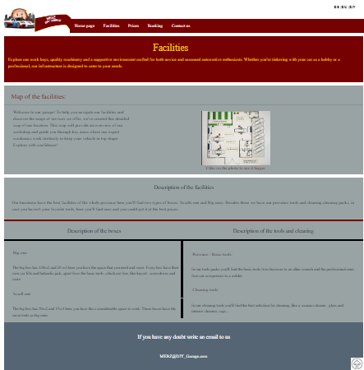
Facilities

Slide 16
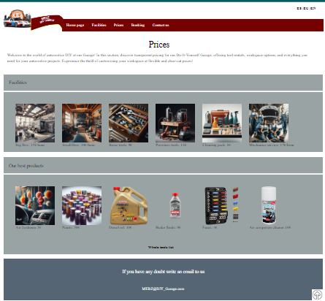
Prices

Slide 17
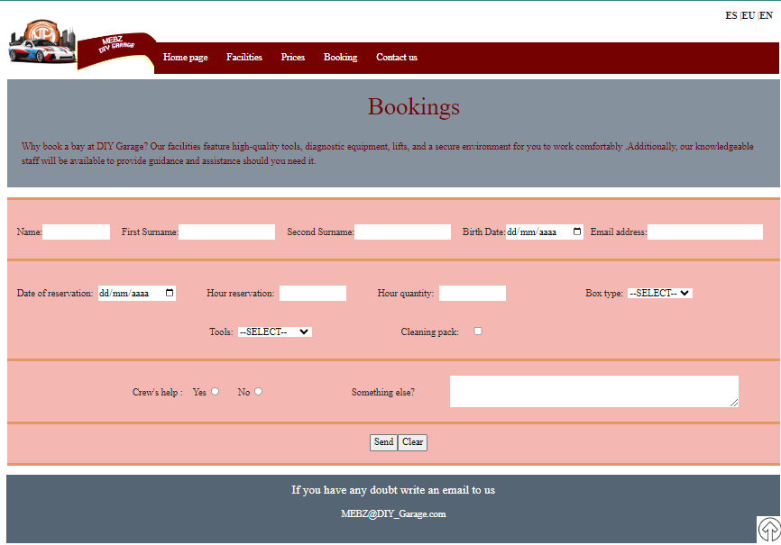
Bookings

Slide 18
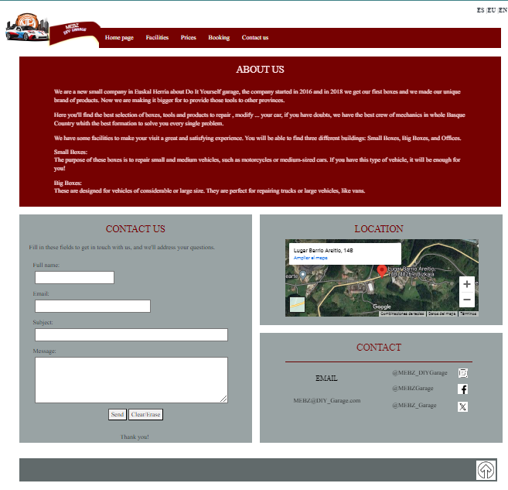
Contact us

Slide 19
Iker Palomares
SYSTEM

Slide 20
TABLE OF CONTENTS
Hardware
01
Software
02
The components we are going to use for the PCs
How did we install the software

Slide 21
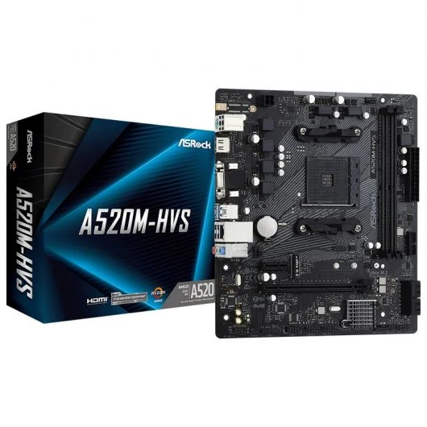
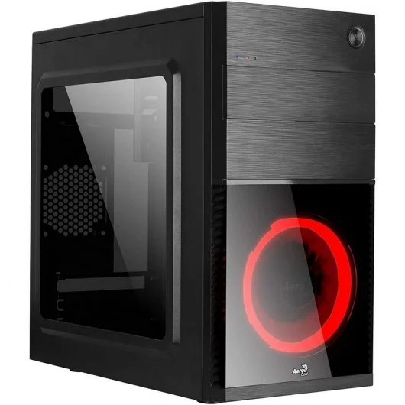
Aerocool CS-105 USB 3.0 Negra/Roja con Ventana
Asrock A520M-HVS

Slide 22

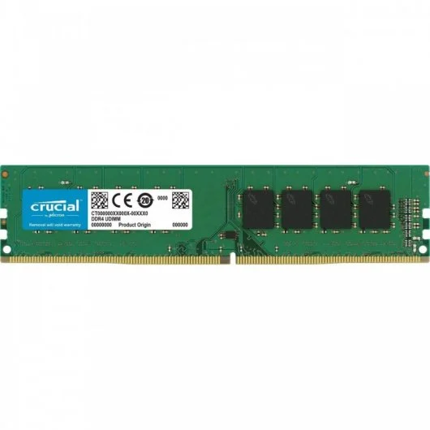
Crucial CT16G4DFRA32A DDR4 3200Mhz PC4-25600 16GB CL22
AMD Ryzen 5 3600 3.6GHz 32MB

Slide 23


NOX Hummer Alpha 600W 80 Plus Bronce
Samsung 870 QVO SSD 1TB SATA3

Slide 24
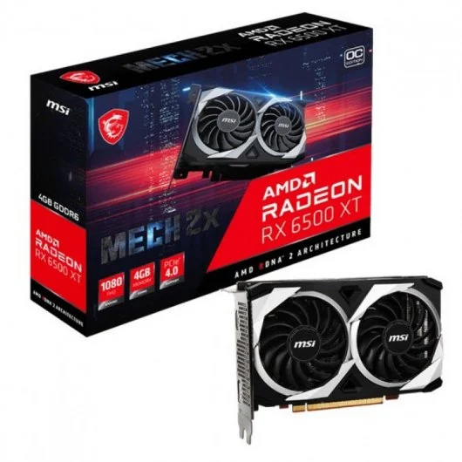
MSI AMD Radeon RX 6500 XT MECH 2X OC 4GB GDDR6

Slide 25
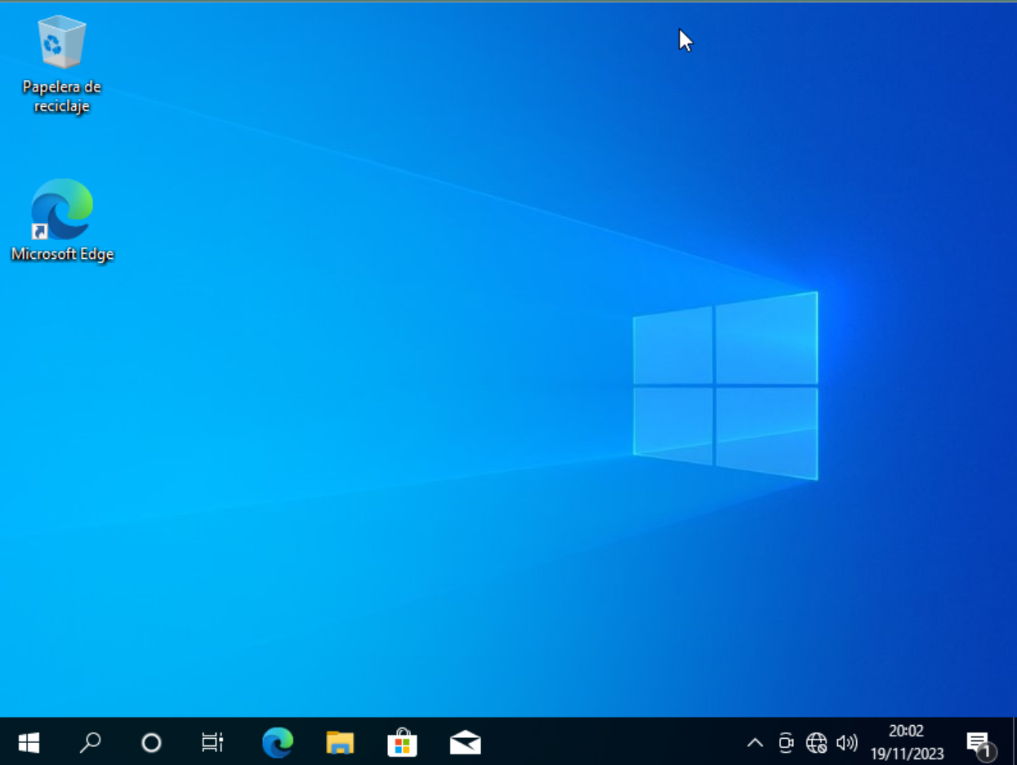
Windows 10
We installed windows 10 pro in two machines and then we make a folder in one machine that is shared with the other

Slide 26
Oier Letamendia,Yeray Escabias and Iker Palomares
DATA BASE

Slide 27
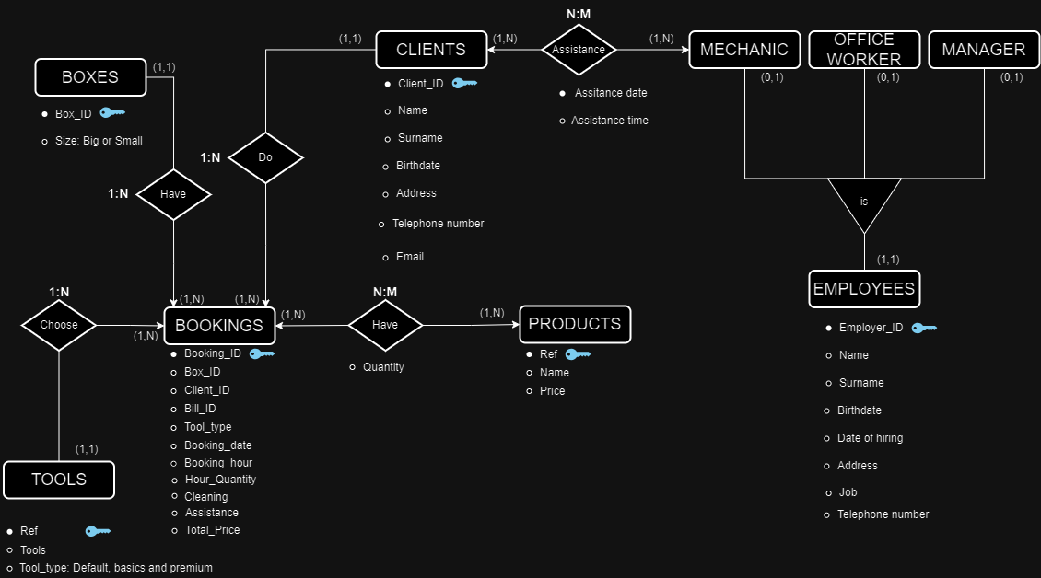
E/R Diagram

Slide 28

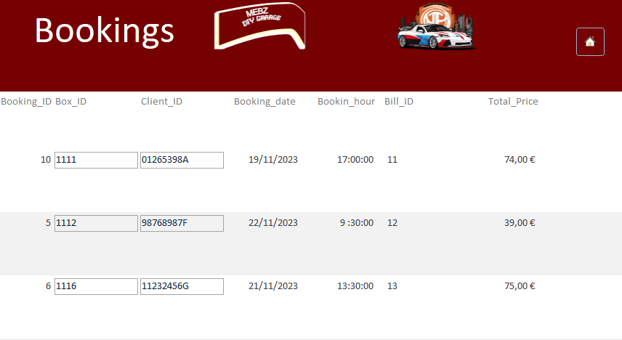
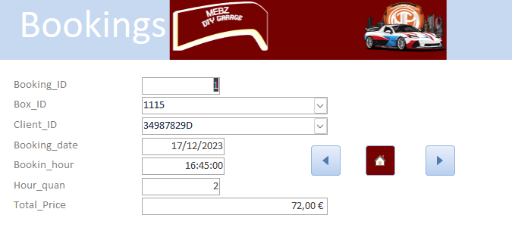
Acces Menu

Slide 29
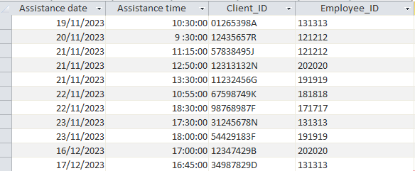
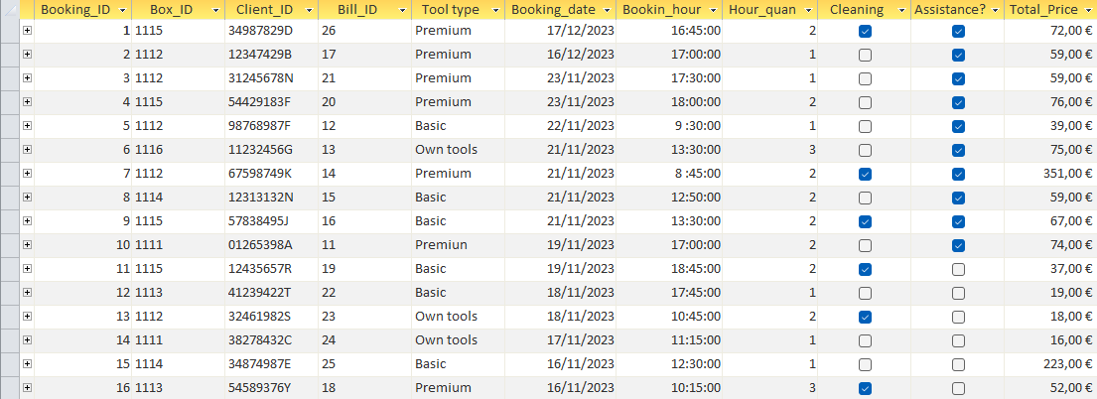
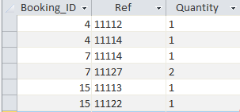
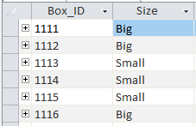
TABLE OF CONTENTS
01
Assistance
02
Bookings
03
Bookings-products
04
Boxes

Slide 30
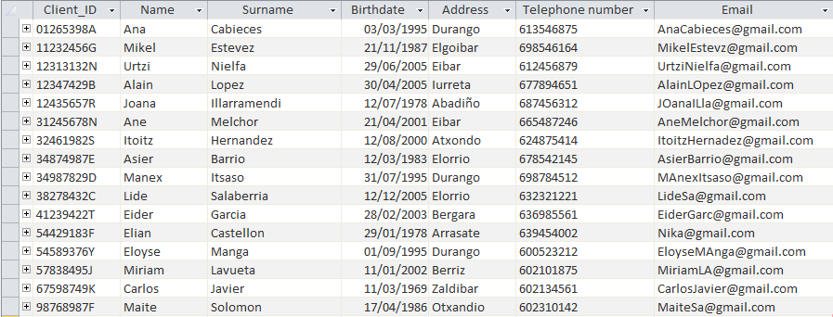
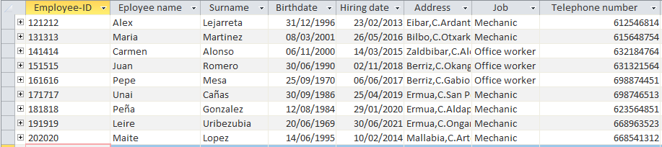
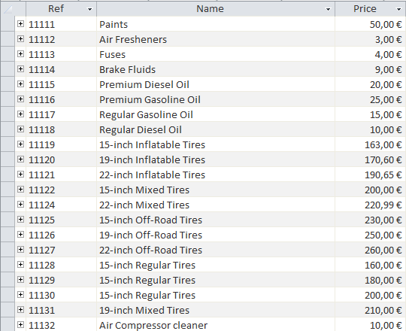
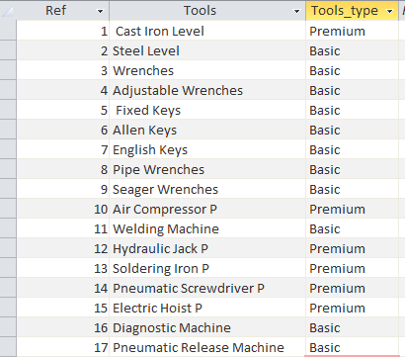
TABLE OF CONTENTS
05
Clients
06
Employees
07
Products
08
Tools

Slide 31
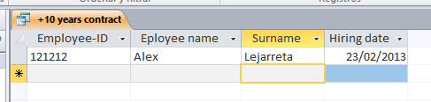
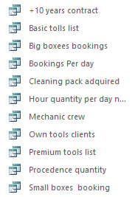
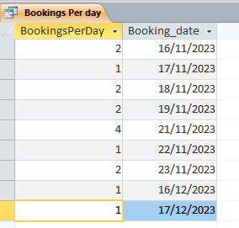
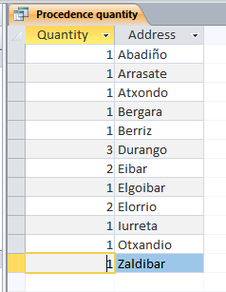
Queries

Slide 32

Documentation

Slide 33
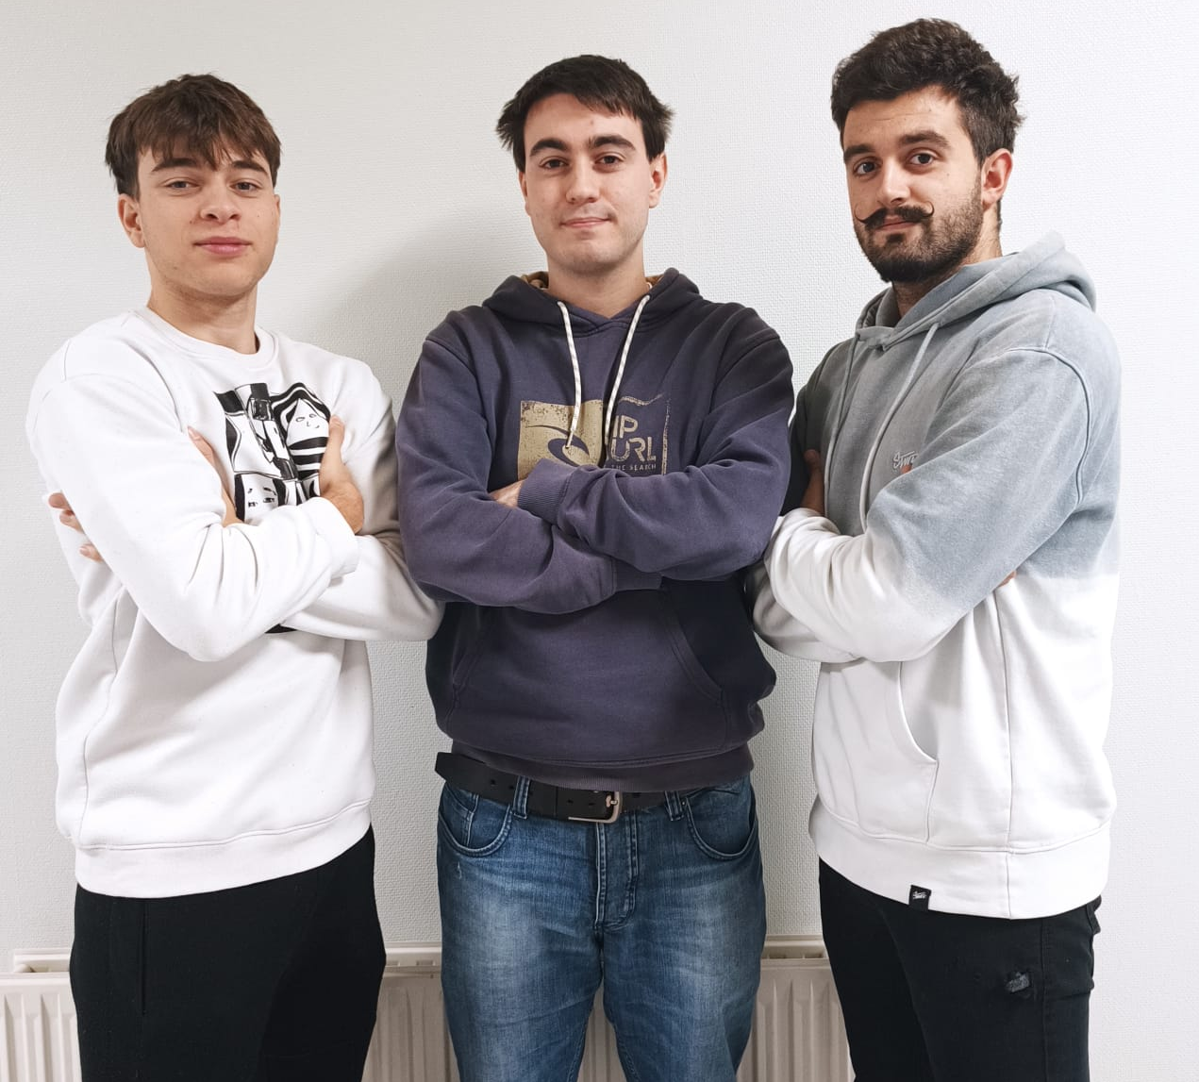
THANKS!
Does anyone have any question?

